Slide 1
CUSTOMER RETENTION-PROJECT
Submitted By:
ANJANA.P

Slide 2
Content
Problem Statement
Data Review
EDA Analysis
Visualizations
Steps and Assumptions
Model Dashboard
Conclusions

Slide 3
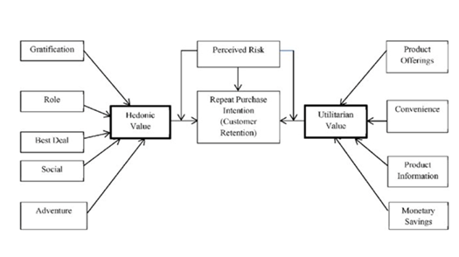
PROBLEM STATEMENT
This project is based on e-retail customer activation and retention from e-commerce customers
Major factors that contributed to the success of an e-commerce store have been identified as: service quality, system quality, information quality, trust and net benefit.
The data is collected from the Indian online shoppers.
success factors, which are very much critical for customer satisfaction.
The factors which influence the customers to repeat purchase are utilitarian values and hedonic values

Slide 4
DATA REVIEW
This project is based on unsupervised learning.
This is a survey data from online customers
We have to perform EDA analysis and also form clusters in our analysis.
The main objective behind this project is to make an understanding of online services that are widely accepted nowadays.
E-commerce overcome geographical limitations, provide goods at lower cost, provide abundant information, eliminate travel time and cost, provide comparison shopping etc.

Slide 5
EDA ANALYSIS
There are 269 rows and 71 columns
There are no null values
Object datatypes are converted to integer using LabelEncoder
Unnecessary columns which provide no information for analysis are dropped
Boxplot is used to check for the presence of outliers
Univariate ,Bivariate analysis are done to get a better understanding of the data
Standard scaler is used to scale the datas to similar magnitude

Slide 6
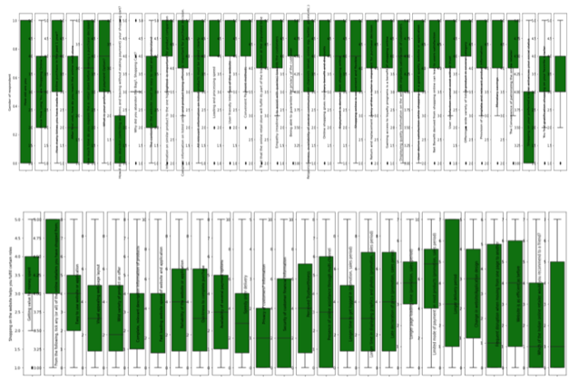
VISUALIZATIONS
BOXPLOT

Slide 7
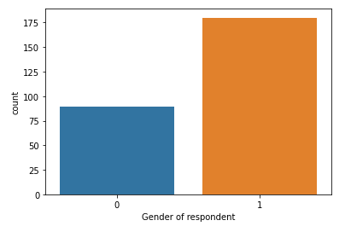
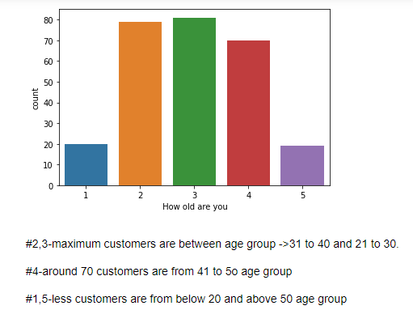
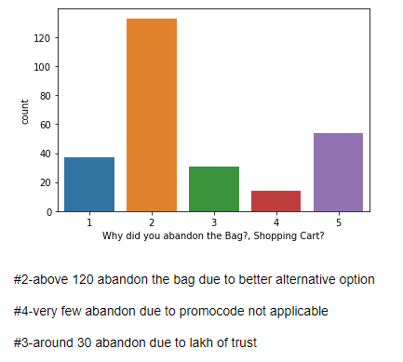
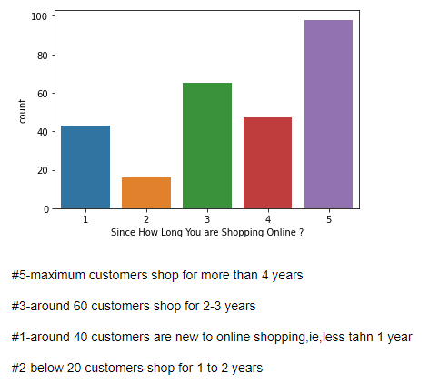
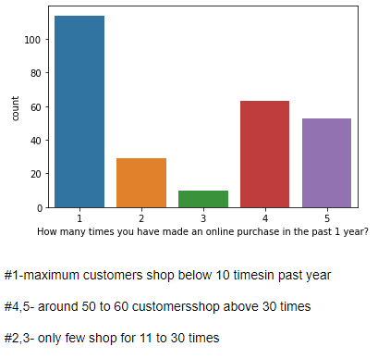
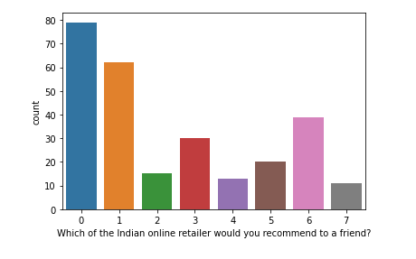
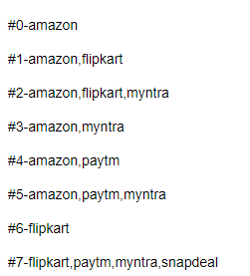
UNIVARIATE ANALYSIS

Slide 8
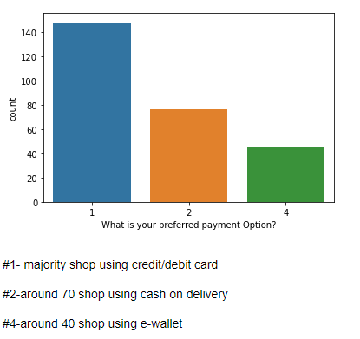
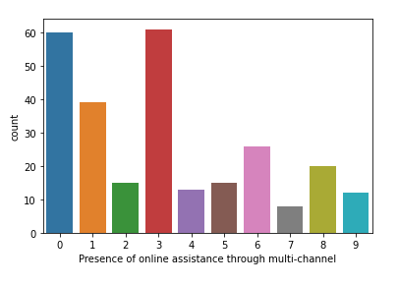
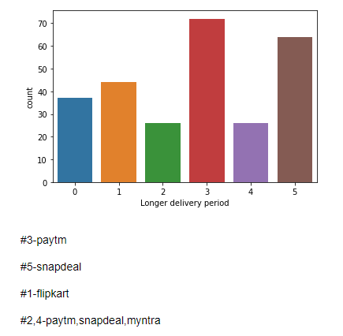
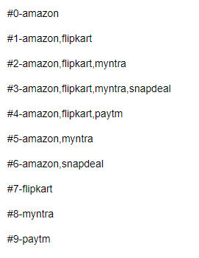
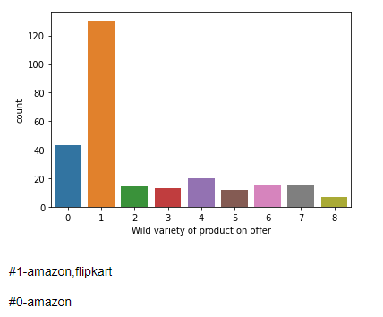
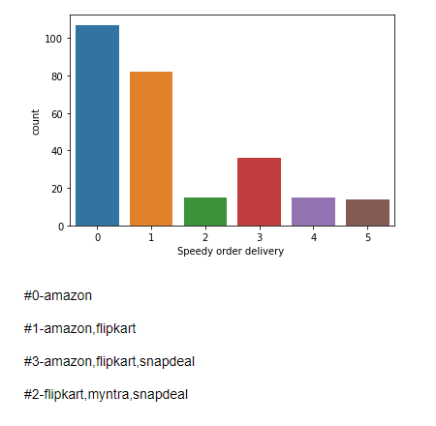
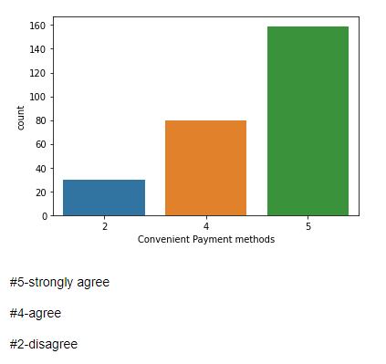

Slide 9
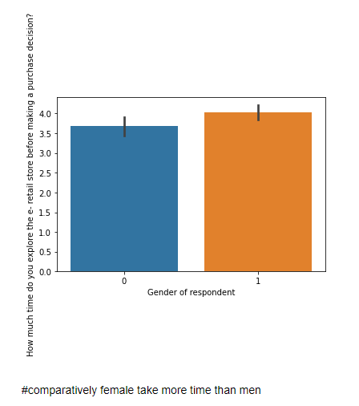
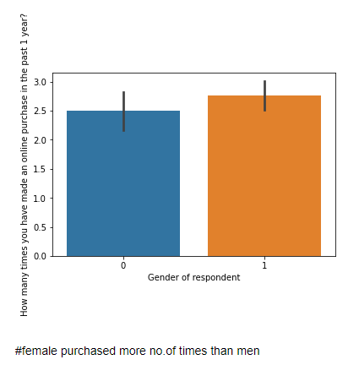
BIVARIATE ANALYSIS

Slide 10
STEPS AND ASSUMPTIONS
From this analysis we understood that customers depend on various factors for their purchase through online.
There are customers with more than 4 years of purchase history
More customers are females ageing from 20 to 40
Customers prefer credit/debit card and also easy and convenient mode of payment options
More preferred online sites among customers are amazone and flipkart
Less preferred sites are paytm and snapdeal
It is because of their best offers, speedy delivery ,good online assistance etc
Customers can be retained through offers, convenient site usage ,easy and better payment options and also through developing trust

Slide 11
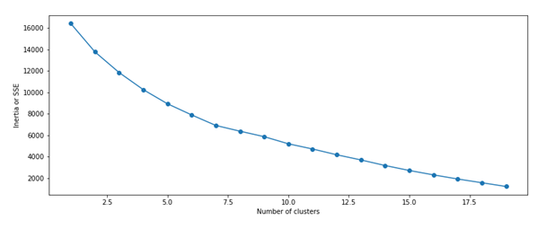
MODEL DASHBOARD
K-means algorithm is used to find the inertia of the model.
Inertia is the sum of squared distances of samples to their closest cluster centre.
Elbow method is used to find the number of clusters needed for our model.
A line chart of SSE is plotted for each value of K and if the line chart looks likes an arm then elbow of the arm is the value of k that is the best for selecting number of clusters

Slide 12
CONCLUSION
There are various clustering methods used in unsupervised learning
K-Means algorithm is centroid based
Using K-means algorithm we get 4th cluster has maximum number of sampleas and 5th cluster has minimum no.of samples
Factors that attracts customers to online stores are presence of online assistance, many offers, convenient payment options, less delivery period, easy return policy etc.
Customers look more for their convenience, brands, value for their cash, offers, trust etc
Customers can be retained by implementing a customer feedback loop, customer education programme, build trust ,offer unique services, start customer retention programme, provide better payment options, decrease shipping cost etc

Slide 13
THANK YOU.

